Slide 1
The Session Initiation Protocol (SIP)
107214005 田蕙瑜

Slide 2
Content
SIP Advantages
How SIP works?
Redirect and Proxy Servers
Example

Slide 3
SIP Advantages
Flexibility
Doesn’t care what type of media is to be exchanged
Can be carried over different transport protocols
Enable custom services and features

Slide 4
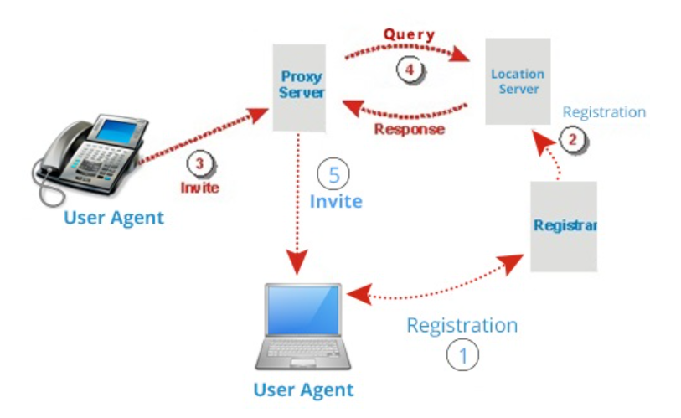
How SIP works? - Architecture
User Agent(UA)
Proxy Server
Redirect Server
Registrar
(Location Server)
Picture: Tutorials Point

Slide 5
How SIP works? – Messaging Syntax
message = ( request-line | status-line )
*message headers
CRLF
[message body]
Request e.g. INVITE, ACK, BYE, CANCEL, OPTION, REGISTER
Status code(response) e.g.200 OK, 404 NOT FOUND

Slide 6
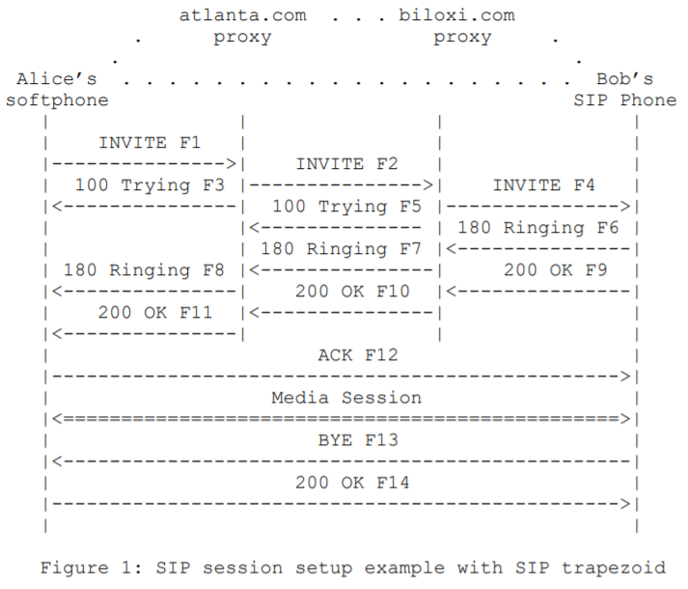
How SIP works? – Messaging Syntax

Slide 7
How SIP works? – Addressing
URL: ras://GUI@somedomain
as known as
SIP Uniform Resource Indicators(URIs)
sip:user@host
e.g. sip:0912345678@sip.ncnu.net
e.g. sip:test@sip.linphone.org

Slide 8
How SIP works? – Messaging Syntax
INVITE sip:bob@biloxi.com SIP/2.0
Via: SIP/2.0/UDP pc33.atlanta.com;branch=z9hG4bK776asdhds
Max-Forwards: 70
To: Bob <sip:bob@biloxi.com>
From: Alice <sip:alice@atlanta.com>;tag=1928301774
Call-ID: a84b4c76e66710@pc33.atlanta.com
CSeq: 314159 INVITE
Contact: <sip:alice@pc33.atlanta.com>
Content-Type: application/sdp
Content-Length: 142
(Alice's SDP not shown)

Slide 9
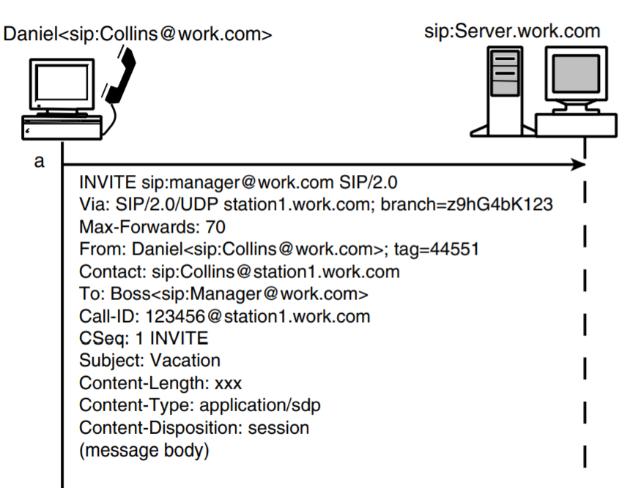
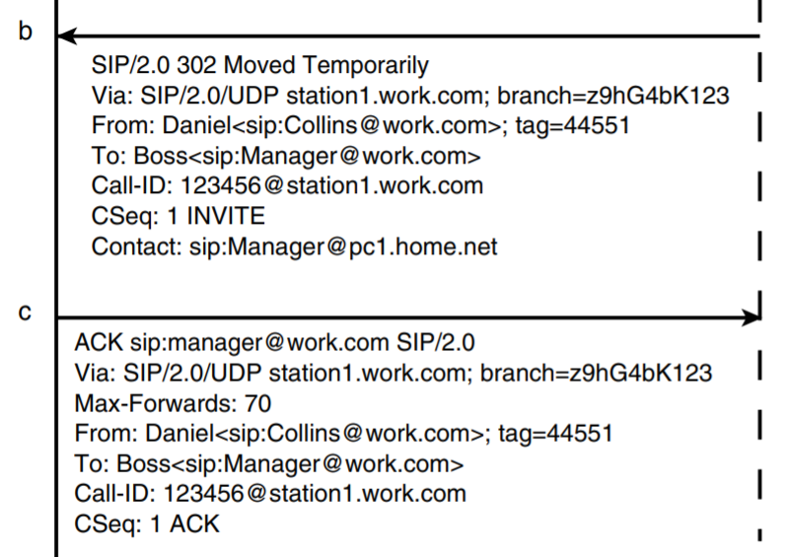
Redirect and Proxy Servers – Redirect server

Slide 10
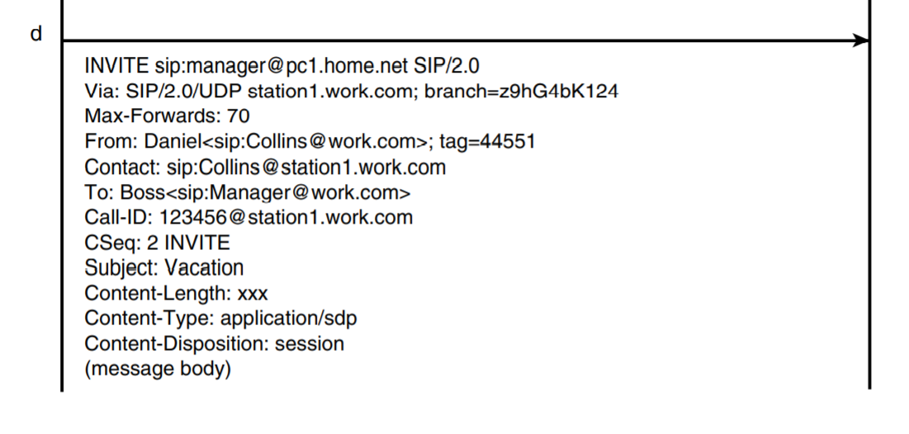
Redirect and Proxy Servers – Redirect server

Slide 11
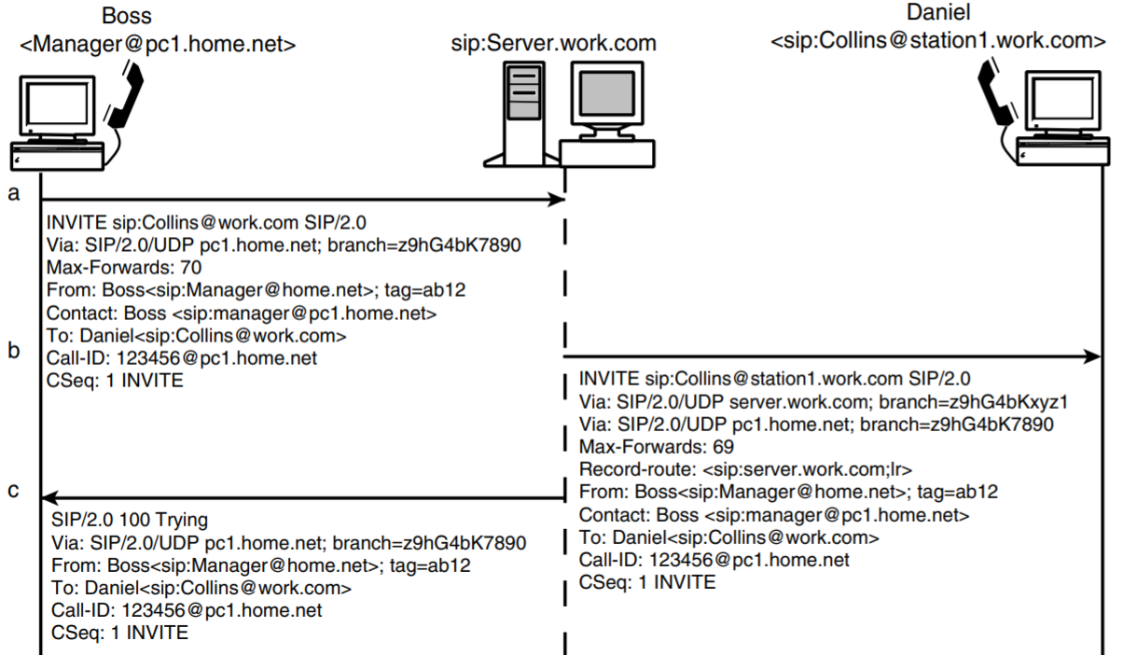
Redirect and Proxy Servers – Proxy server

Slide 12
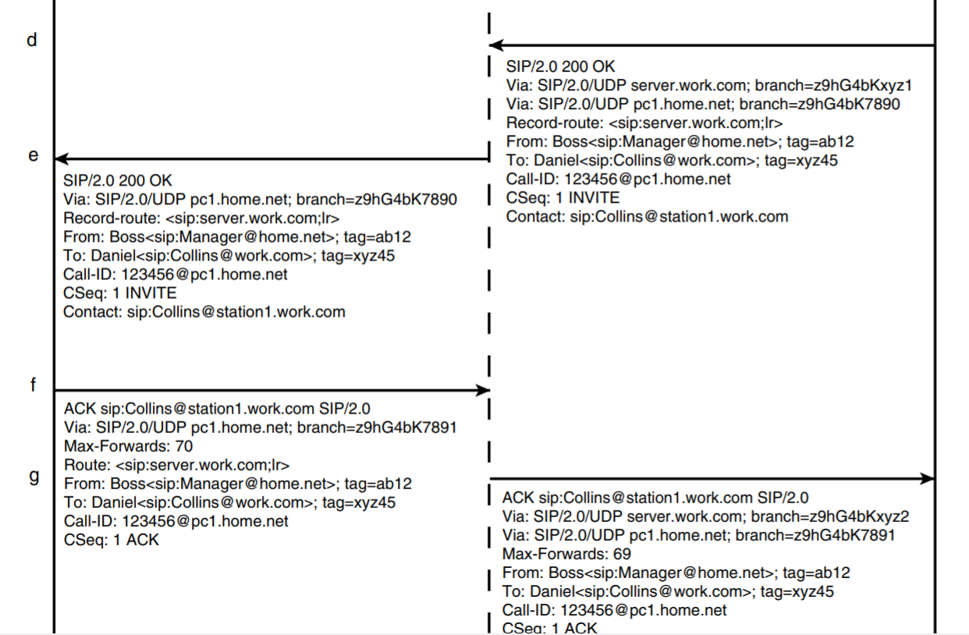

Slide 13
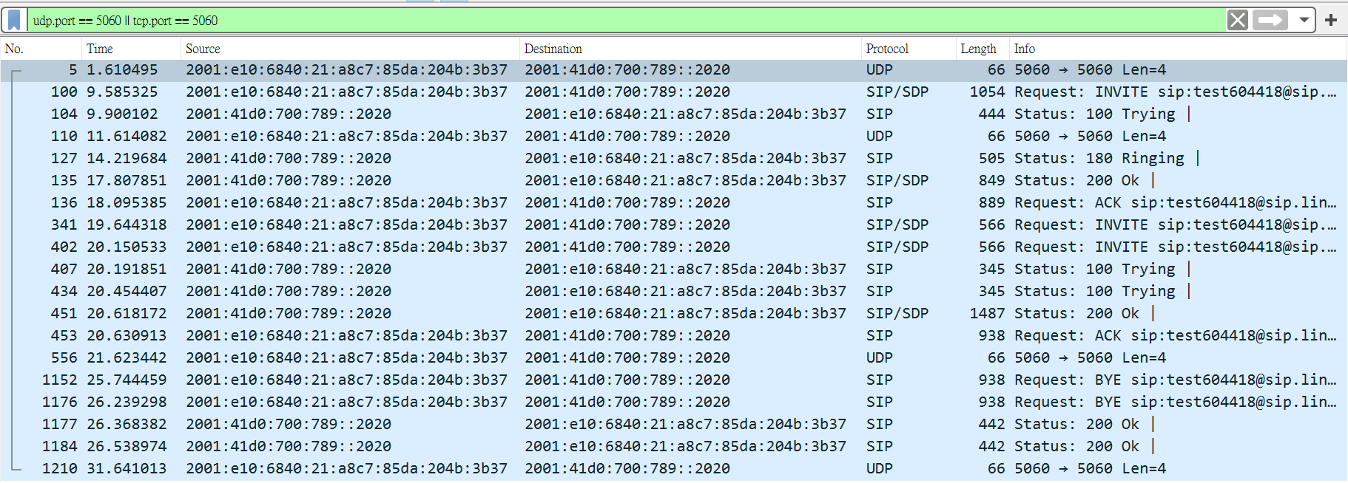
Example
There are SIP packages during the call.

